Slide 1
Non-standard employment in Sweden
Centraal Planbureau, The Hague, Netherlands, November 18, 2016
Per Skedinger
IFN, Linnaeus University and Swedish Labour Policy Council

Slide 2
Overview
Types of non-standard employment
Institutions
Some facts and figures
Consequences of non-standard employment
Concluding discussion

Slide 3
Types of non-standard employment in Sweden
Part-time employment
Fixed-term employment
Temporary work agency employment
Dependent self-employment (statistically insignificant according to Eurofund, 2010)
My focus will be on fixed-term and part-time employment

Slide 4
Institutions
Social security and public pensions
Legal framework
- Employment protection legislation
- Anti-discrimination legislation
Collective agreements

Slide 5
Pensions and social rights for those on fixed-term contracts and part-timers
Basically the same rights as for regular workers
All benefits (holiday pay, sickness insurance
pay, etc.) are proportional to earnings

Slide 6
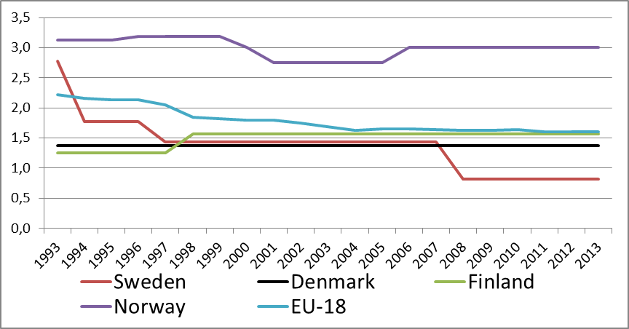
Stringency of employment protection legislation.
Fixed-term employment. Index
Source: OECD, index EPT_V1

Slide 7
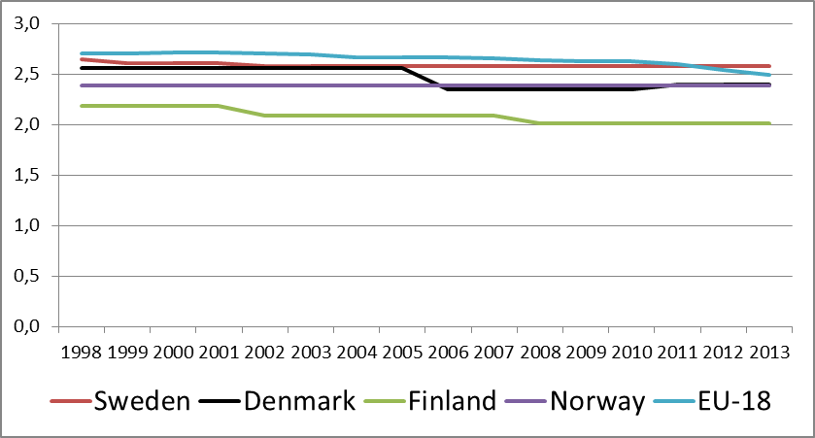
Stringency of employment protection legislation.
Permanent employment. Index
Source: OECD, index EPRC_V2

Slide 8
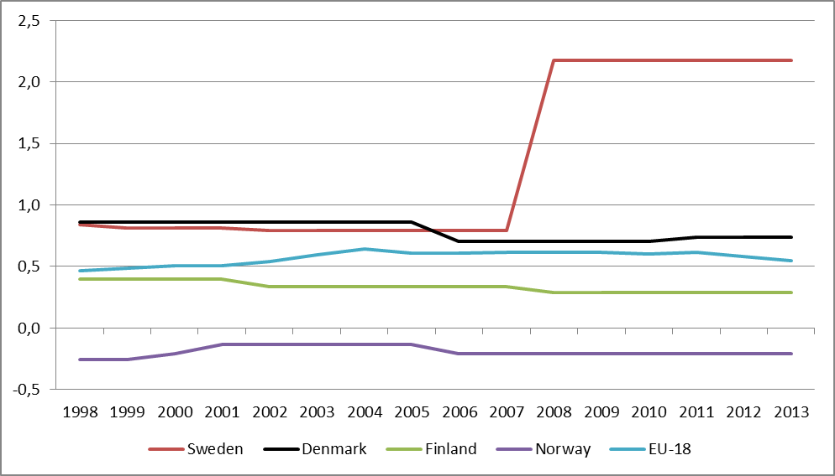
Gap in stringency of employment protection legislation. EPRC – EPT/ EPT
Source: OECD, index EPT_V1 and index EPRC_V2

Slide 9
Anti-discrimination legislation
Employers are prohibited by law (2002:293) to discriminate against fixed-term and part-time workers in relation to regular workers, unless there are objective reasons for differential treatment (qualifications, tenure, etc.)
Burden of proof lies with the employer
Seems to be few legal cases in the Labour Court concerning such discrimination

Slide 10
Collective agreements (90 % coverage)
Parts of employment protection legislation – but not anti-discrimination legislation – can be undone in collective agreements
Some agreements impose more stringent rules for fixed-term employment (used to be other way around when legislation was more restrictive)
Some agreements stipulate that the possibilities to offer part-timers full-time jobs should be investigated before additional (part-time) workers are recruited

Slide 11
Some facts and figures
Evolution and demographics of non-standard employment
Fixed-term employment as a buffer during economic downturns
Among Nordic countries, Sweden stands out with highest over-representation of marginal groups in fixed-term employment

Slide 12
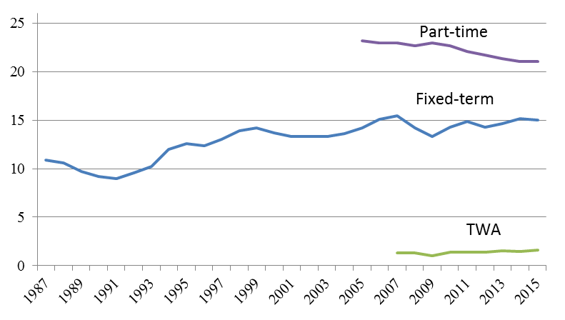
Evolution of non-standard employment.
Per cent of total employment
Sources: Statistics Sweden, Swedish Staffing Agencies

Slide 13
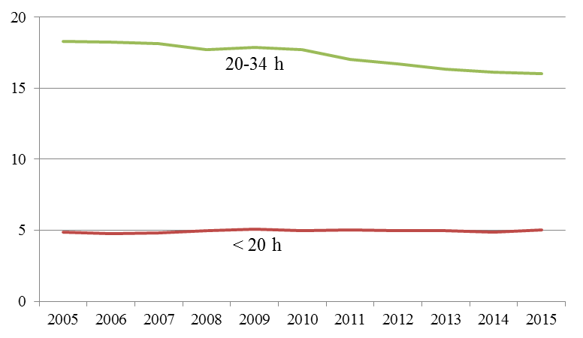
Evolution of long and short part-time employment.
Per cent of total employment
Source: Statistics Sweden

Slide 14
Demographics of fixed-term and part-time employment. Per cent of total employment, 2015
Note: Ages 15-74
Source: Statistics Sweden, Eurostat

Slide 15
Change in number of employees during two financial crises. Per cent
Source: Adapted from Skedinger (2012)
Type of contract | 1990-94 crisis | 2008-10 crisis
Open-ended | –15,8 | – 1,1
Fixed-term | 5,6 | –11,1

Slide 16
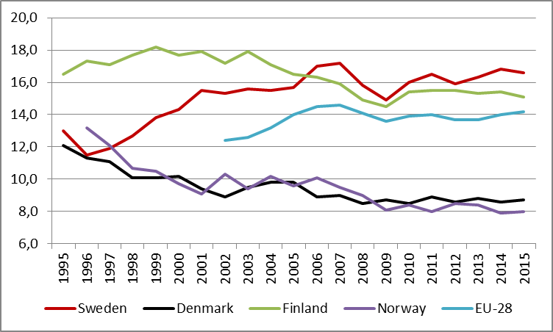
Fixed-term employment as percentage of dependent employment, age 15-64
Source: Eurostat

Slide 17
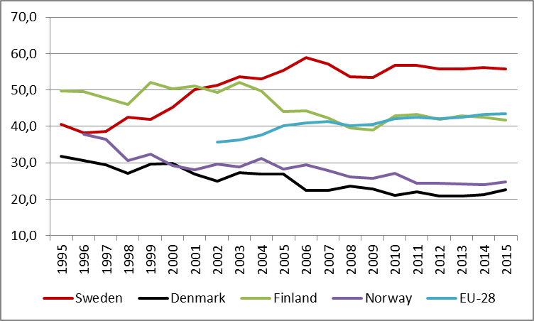
Fixed-term employment as percentage of dependent employment, age 15-24
Source: Eurostat

Slide 18
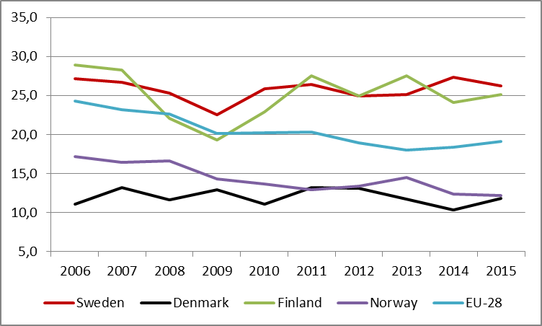
Fixed-term employment as percentage of dependent employment, country of birth outside of EU-28
Source: Eurostat

Slide 19
Calculations of relative risks of fixed-term employment among employees in marginal groups
Group A = employees in marginal group
Group B = employees in non-marginal group
FTE = fixed-term employment
Risk ratio = P(FTE | Group A) / P(FTE | Group B)
= 1 Equal risks
> 1 Higher risk in marginal group
< 1 Lower risk in marginal group

Slide 20
Relative risks of fixed-term employment, various marginal groups, 2015
ª Skill level 1 vs. levels 2-5, 2012; ^{b} EU-17
Source: Own calculations based on data from Eurostat and PIAAC (proficiency)
 | Sweden | Denmark | Finland | Norway | EU-28
Age 15–24 vs. Age 25–64 Born outside of EU-28 vs. Natives Primary education vs. Secondary or tertiary education Occupation requiring primary education vs. Occupation requiring secondary or tertiary education Low proficiency level vs. Not low proficiency levelª Literacy Numeracy | 4.95 1.72 1.93 2.19 2.16 1.80 | 3.79 1.40 2.01 1.15 1.00 1.06 | 3.62 1.71 1.50 1.73 0.94 1.06 | 4.59 1.58 1.75 1.79 1.43 1.64 | 3.91 1.39 1.70 1.80 1.22^{b} 1.27^{b}

Slide 21
Consequences for the worker of fixed-term and part-time employment
Outcomes considered in the research:
Wages
Training
Transitions to regular employment
Pensions for part-timers – much-discussed topic in public debate
Sweden has an actuarial pension system, but
with compensation for child-rearing
Source: Statistics Sweden, Eurostat

Slide 22
Wage penalty
Difficult to examine due to selection and endogeneity, and very few studies
But wage penalty seems smaller than in many other countries
Fixed-term: - 10% (Holmlund and Storrie, 2002)
Part-time, females: + 3% (Bardasi and Gornick, 2008)
No study of long-term effects

Slide 23
Training
Less on-the-job training
Fixed-term (Wallette, 2005)
- Effect dependent on type of fixed-term job, gender, country of
birth
Part-time (Sundström, 1987)
- Effect probably smaller today due to more hours worked by
part-timers

Slide 24
Transitions from fixed-term to open-ended contracts
Dependent on type of fixed-term job, country of
citizenship (Håkansson, 2001)
Replacement jobs act as stepping-stones.
Length of contract was exogenous in context of
study and did not matter (Hartman et al., 2010)

Slide 25
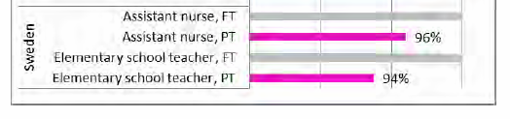
Pension forecasts for standardized cases.
Pensions for part-time female workers (PT) as percentage of pensions for full-time female workers (FT)
Assumptions:
PT is 75 % of full-time for 10 years, rest is full-time
Compensation for child-rearing (two children) included
Career wage growth 1.9 % per year for PT and 2.0 % for FT
Source: Wennemo Lanninger and Sundström (2014)

Slide 26
Concluding discussion
Fixed-term employment is more of a concern than part-time employment
We noted these facts about fixed-term employment:
Large gap in regulation relative to open-ended contracts
Large over-representation of marginal groups
Increasingly used as a buffer during deep recessions
Consistent with insider–outsider theories
(Lindbeck and Snower, 2001)
Full impact of these developments remains to be analyzed

