Slide 1
Minimum Wages
Lecture, Topics in Labour Economics, Linnaeus University, October 18, 2016
Per Skedinger
IFN, Linnaeus University and Swedish Labour Policy Council

Slide 2
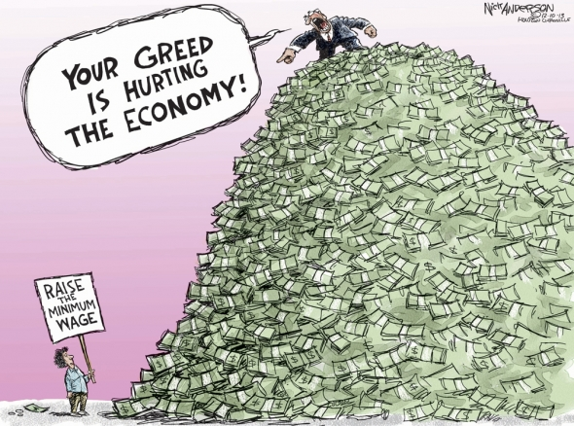
Can we raise the wages of the low-paid…

Slide 3
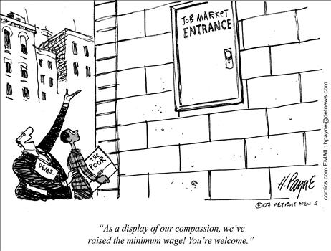
…without hurting their employment?

Slide 4
Outline
Minimum wages as a topic in labour economics
Theory
  Competitive model, monopsony, search and matching models
Measures of bindingness of the minimum wage
  Minimum wage bite, Kaitz index, Wage gap
Institutional framework
  Fixing mechanisms - statutory vs. collectively agreed minimum wages
  Some facts and figures
Empirical studies – int’l and Swedish evidence
  Wages
  Employment
Current policy issue
  The supply of low-skilled workers has increased in Sweden. Would lower minimum wages improve their employment prospects?
Summary and conclusions

Slide 5
Minimum wages as a topic in labour economics
Very large literature
1,200 articles with ”Minimum wage” in title in EconLit database
Almost all empirical studies are based on statutory systems, very few consider collectively agreed minimum wages
Majority of empirical studies use US data

Slide 6
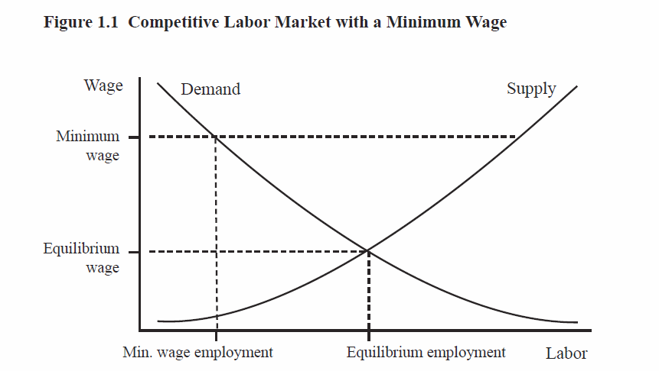
Theory: Competitive model
Source: Belman and Wolfson (2014)

Slide 7
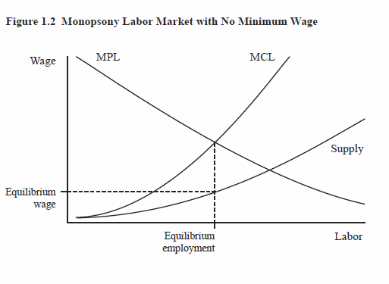
Theory: Monopsony model
Source: Belman and Wolfson (2014)

Slide 8
Theory: Search and matching models
With frictions in labour markets and endogenous search effort among job seekers, a minimum wage hike may increase search effort and the job finding rate, resulting in higher employment.
But if the minimum wage is high enough, i.e., exceeds marginal productivity, firms will not find it profitable to hire these workers and employment decreases.
Cahuc et al. (2014) is a useful textbook treatment of these issues

Slide 9
Theory: Conclusions
Employment consequences of a minimum wage hike:
Predictions in competitive model hold for whole labour market, not necessarily for specific sectors/groups, and for total hours rather than employment
Monopsony / search and matching models predict that employment may increase as the supply of labour / search intensity increases
All models predict that employment decreases if the initial minimum wage is high enough or if the hike is large enough

Slide 10
Measures of bindingness of the minimum wage
Aggregate measures
a) Minimum wage bite or relative minimum wage
Minimum wage / Average or median wage
b) Kaitz index (applicable with incomplete coverage)
Minimum wage bite x Percentage of persons covered
Common in US studies but eligible population not always
well defined

Slide 11
Measures of bindingness of the minimum wage
Measure at individual level – wage gap
i = individual, t = time, w = wage, minw = minimum wage

Slide 12
The institutional framework
Who sets the minimum wage?
- (i) government, (ii) social partners, both (i) and (ii)
How is the minimum wage adjusted?
- frequency, indexation, etc.
Any differentiation of the minimum wage?
- by age, experience, region, industry, etc.

Slide 13
Enactment of nation-wide minimum wage laws
New Zealand 1894
US 1938^{a,b}
France 1950
UK 1999ª
Germany 2015ª
ª Non-nationwide minimum wage law enacted before this date
^{b} State-specific minimum supplants the federal if the former is higher

Slide 14
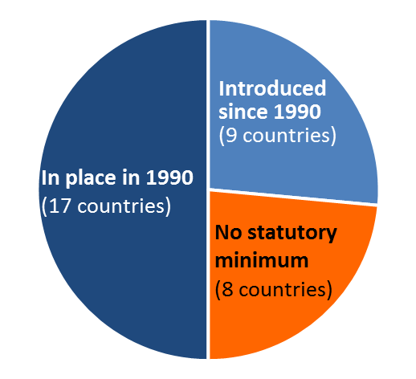
Increasing number of OECD countries have adopted statutory minimum wages since 1990
Source: OECD

Slide 15
Characteristics of collectively agreed minimum wages (in relation to statutory)
Higher
Boeri (2012)
Sectoral
More differentiated according to worker characteristics
With high coverage of collective bargaining, functionally equivalent to statutory minimum wages
Garnero et al. (2015)

Slide 16
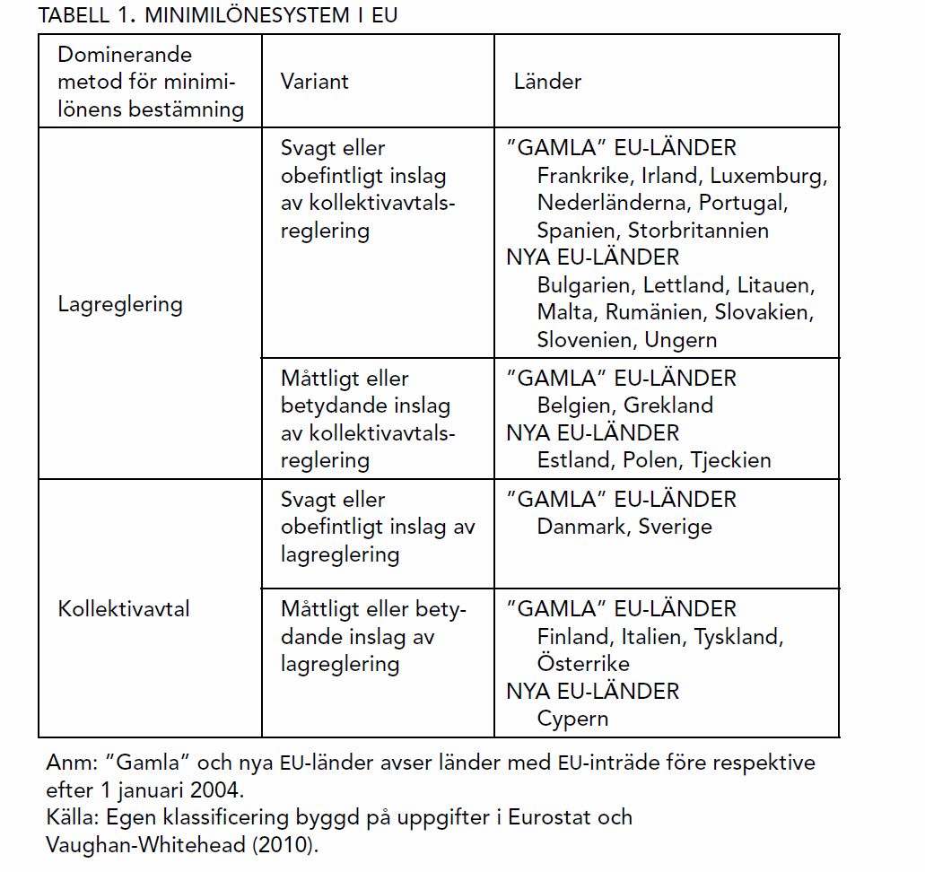
Minimum wage systems in the EU
Source: Skedinger (2012)

Slide 17
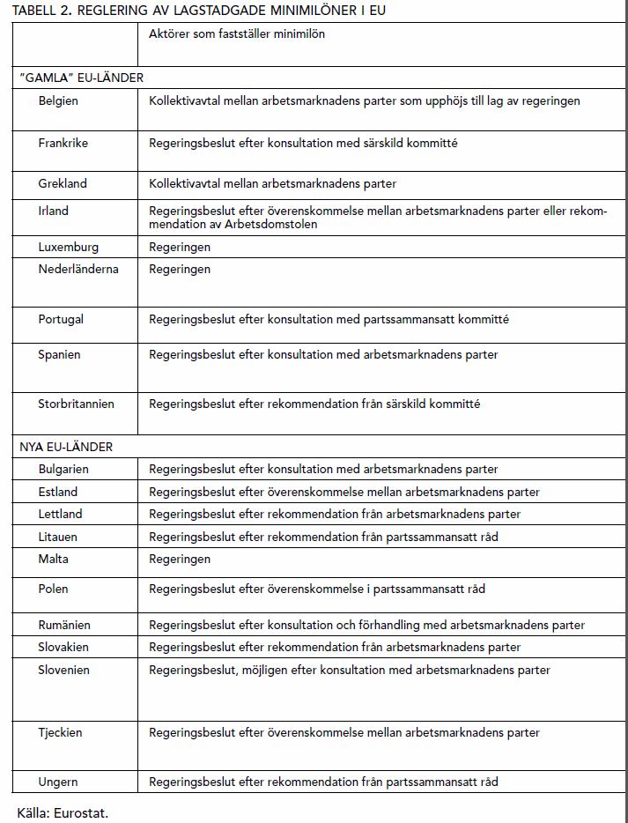
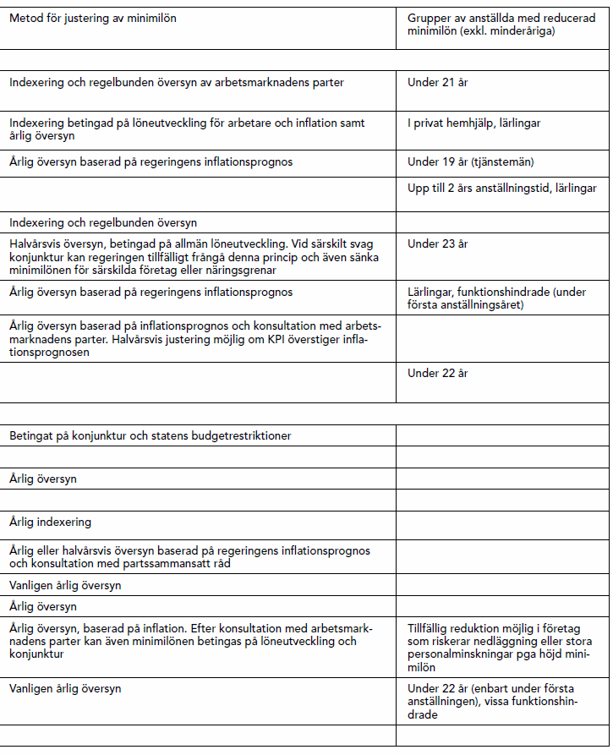
Minimum wage regulation in statutory systems in the EU
Source: Skedinger (2012)

Slide 18
Minimum wage in relation to median wage in selected OECD countries and four Swedish collective agreements, per cent
Source: Swedish Labour Policy Council (2016)

Slide 19
Wage effects of the minimum wage
Average wages
Wages of those close to minimum wage – ”spike-ology”
Wages of those above minumum wage – spillovers
Wage dynamics of those close to minimum wage – springboard jobs or dead end jobs?
Inequality and distribution of wages
Income of low-income (poor) households

Slide 20
Average wages: A mechanical exercise
Assume two groups of workers, A and B, of equal size in the economy and with different hourly wages
W^{A} = W^{min} =100; W^{B} = 150; Ŵ = 125
Raise the minimum wage by 10 % (with complete compliance, no supply effects and no spillovers)
Extreme case 1: All in A keep job.
W^{A} = W^{min} =110; W^{B} = 150; Ŵ = 130
Extreme case 2: All in A laid off.
W^{B} = Ŵ = 150
Interval we get: 130 ≤ Ŵ ≤ 150

Slide 21
Average wages
Several US studies look at average wages of vulnerable groups – teens, the less educated, etc.
Use state-by-time panels or repeated cross sections of individuals
Most find that average wages of vulnerable groups increase
E.g.; Allegretto et al. (2011); Easton (2006); Neumark & Wascher (2011).
Exception: Sabia (2008)
Capture wage effects for both those bound by minimum wage and those above

Slide 22
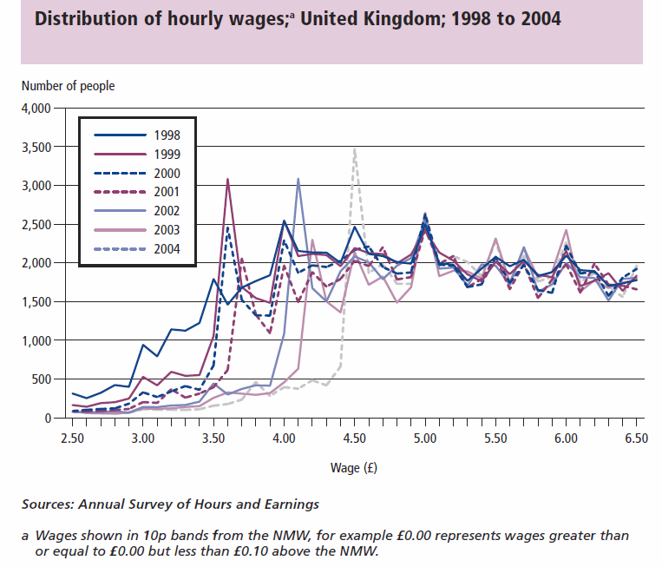
”Spike-ology”
Introduction of National Minimum Wage in UK
Source: Lam et al. (2006)

Slide 23
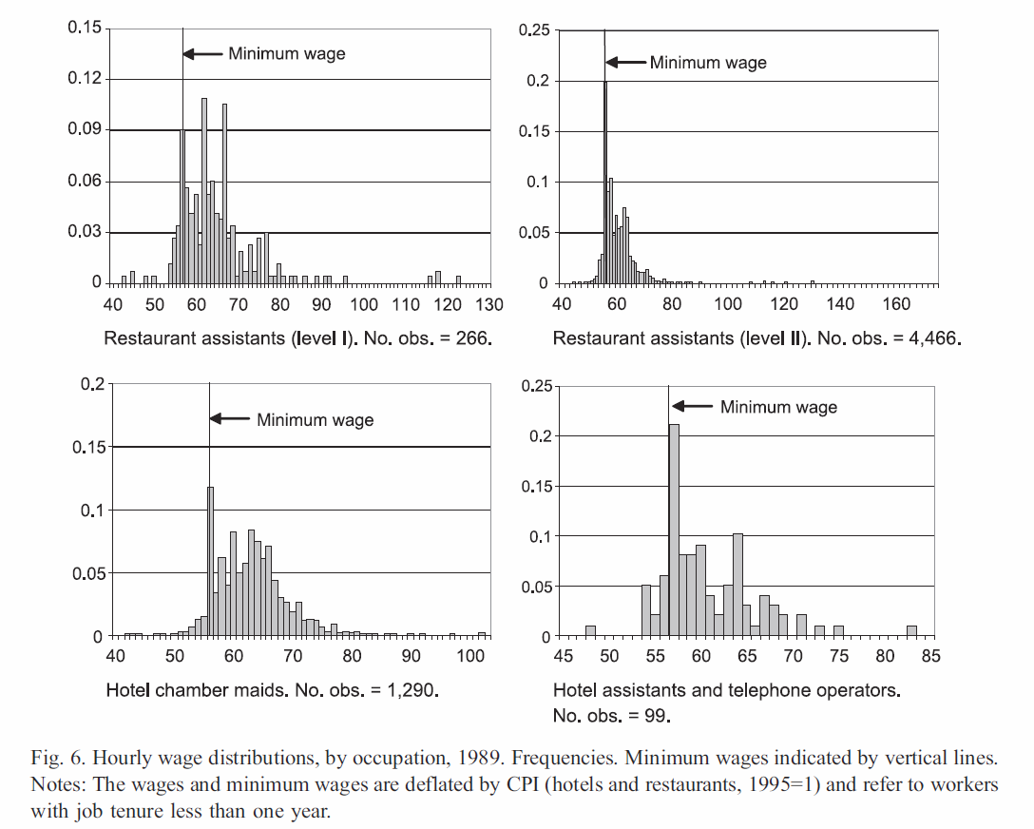
”Spike-ology”
Swedish hotels and restaurants, blue-collar workers, by occupation
Source: Skedinger (2006)

Slide 24
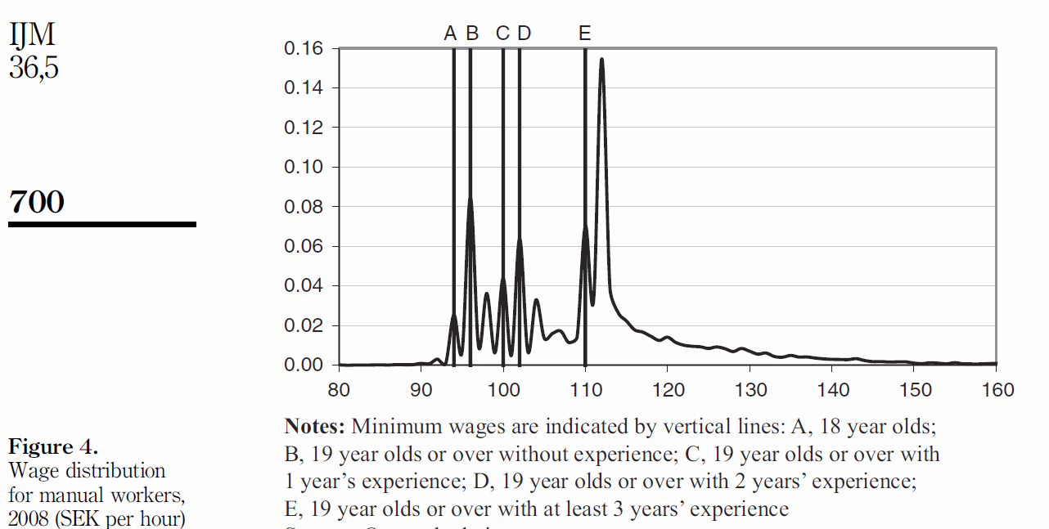
”Spike-ology”
Swedish retail industry, blue-collar workers, by age and experience
Source: Skedinger (2015)

Slide 25
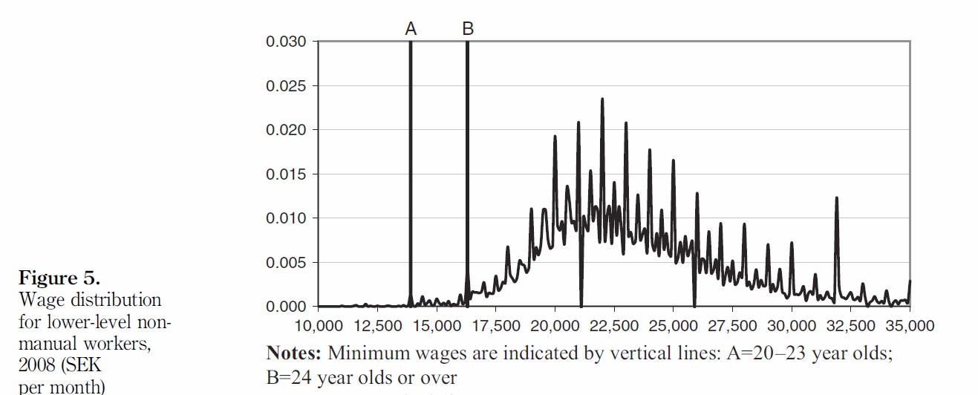
”Spike-ology”
Swedish retail industry, white-collar workers, by age
Source: Skedinger (2015)

Slide 26
Wage effects for those close to the minimum wage
We looked at snaphots of the wage distribution in previous figures
Longitudinal data allow (i) analysis of how wages of individuals develop over time and (ii) control for unobserved personal characteristics that affect wages

Slide 27
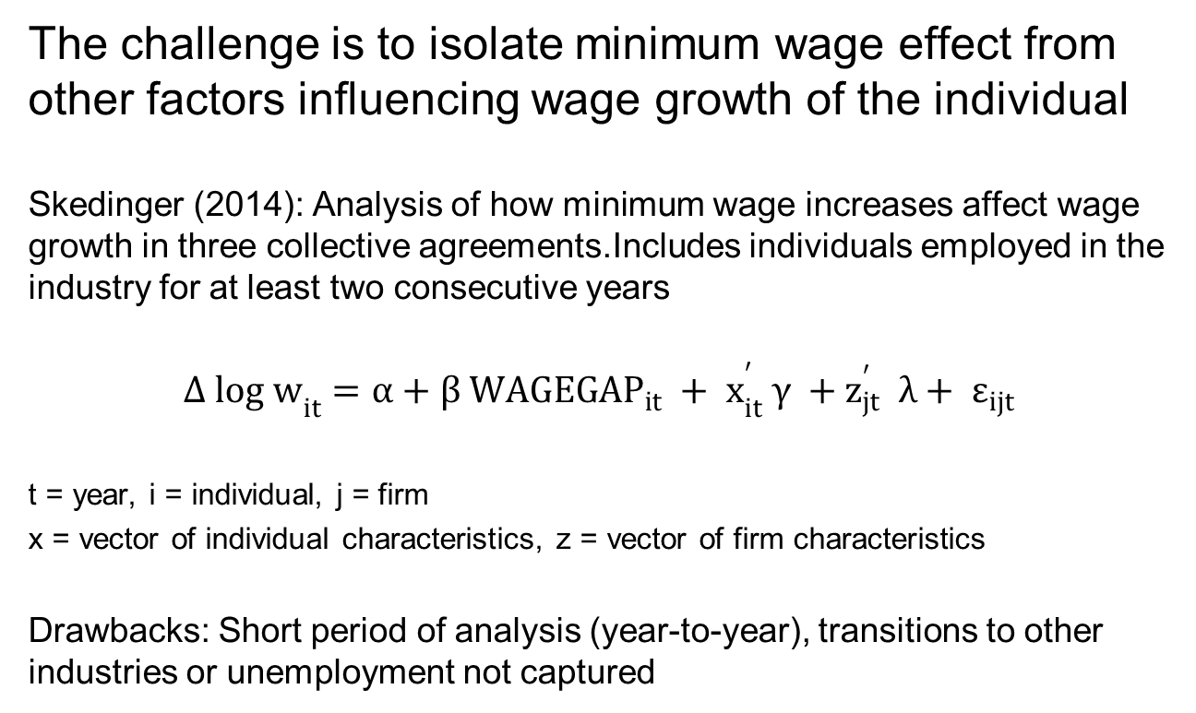
Wage effects for those bound by minimum wage: Formal analysis for Sweden
The challenge is to isolate minimum wage effect from other factors influencing wage growth of the individual
Skedinger (2014): Analysis of how minimum wage increases affect wage growth in three collective agreements.Includes individuals employed in the industry for at least two consecutive years
$${Δ log w}_{it}^{}={α+β {WAGEGAP}_{it} + x}_{it}^{′} γ {+ z}_{jt}^{′} λ+ ε_{ijt}$$
t = year, i = individual, j = firm
x = vector of individual characteristics, z = vector of firm characteristics
Drawbacks: Short period of analysis (year-to-year), transitions to other industries or unemployment not captured

Slide 28
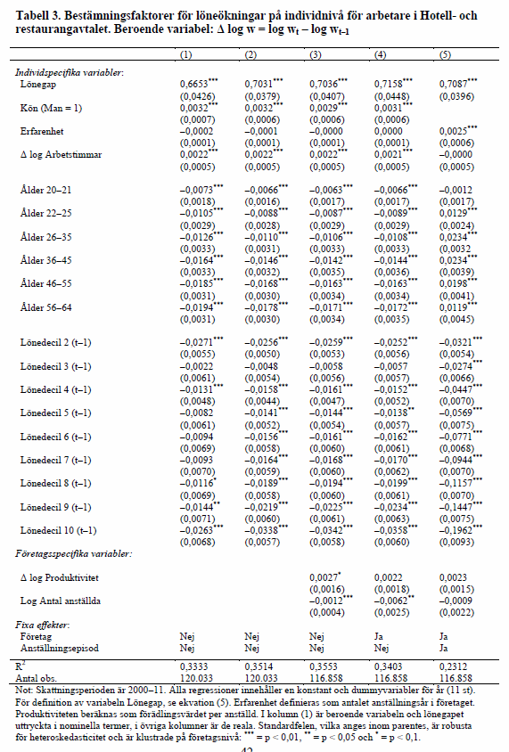
Hotels and restaurants: $β$ = 0,7
Source: Skedinger (2014)

Slide 29

$β$tends to be less than 1 in the literature.
Why?
Because some wage growth would occur even without minimum wage increases
Workers become more productive over time, also in jobs which require low formal qualifications
Source: Skedinger (2014)

Slide 30
Wage effects for those bound by minimum wage: International evidence
Studies that cover the whole labour market
Mixed results: 2 out of 3 indicate positive wage effect
US: Currie & Fallick (1996); Zavodny (2000)
UK: Stewart (2004)
Study for single firm in US indicates positive effect: Giuliano (2013)

Slide 31
Wage effects for those above minimum wage.
Why spillovers?
Production technology or relative wage concerns
Employers may substitute more productive workers for less productive, causing an increase in wages of the former group
Experimental evidence that people use minimum wage as benchmark to judge adequacy of own wage (Falk et al., 2006)

Slide 32
Wages for those above minimum wage.
Findings
US: Most studies suggest spillovers, but magnitude varies (decile 1 – decile 3).
E.g.: Autor et al. (2016); Card & Krueger (1995); Harvey & Bernstein
(2003); Reich & Hall (2001)
UK: Mixed results, but mostly small (0 – decile 3)
E.g.: Butcher (2005); Dickens & Manning (2004); Stewart (2012)
Germany: One study found large effects depending on occupation, collective agreement coverage and region
Rattenhuber (2014)
No Swedish studies, but both unions and employers claim that spillovers exist!

Slide 33
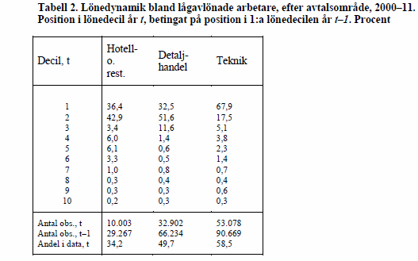
Wage dynamics of those close to minimum wage (decile 1): Three Swedish collective agreements
Drawbacks: Short period of analysis (year-to-year), transitions to other industries or unemployment not captured
Source: Skedinger (2014)

Slide 34
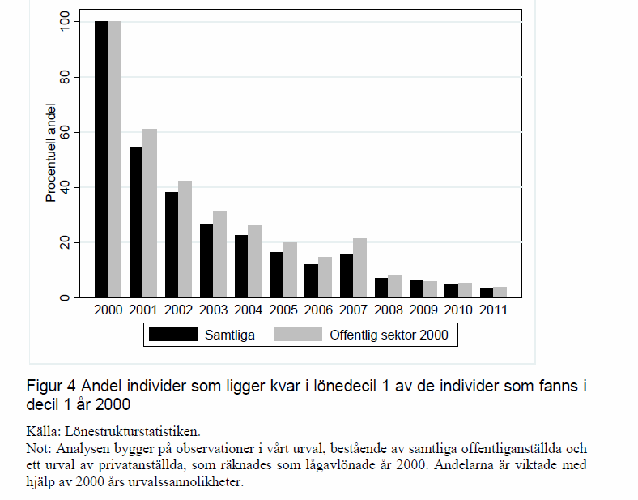
Wage dynamics of those close to minimum wage (decile 1) in Sweden: Whole labour market, 11-year horizon
Source: Forslund et al. (2012)

Slide 35
Wage dynamics of those at or close to minimum wage: International evidence
Few studies, but they suggest a majority transit to higher-wage jobs within 2-3 years
A substantial proportion remain at minimum wage (the less educated)
US: Carrington & Fallick (2001); Even & Macpherson (2003);
Long (1999); Smith & Vavrichek (1992)
UK: Phimister & Theodossiou (2009)

Slide 36
Inequality and distribution of wages: International evidence
Decline in real minimum wage in US seems to explain substantial part of rise in inequality in lower tail of wage distribution
E.g: Autor et al. (2010); Lee (1999); Lemieux (2002, 2006)
Similar conclusion for lower relative minimum wage in UK
Dolton et al. (2012)
Both statutory and collectively agreed minumum wages with high coverage are associated with lower levels of wage inequality in European countries
Garnero et al. (2015)

Slide 37
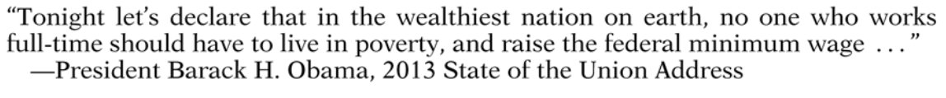
Minimum wage: An efficient tool to combat poverty?
Most studies indicate little or no impact on the number of individuals or households living below the official poverty line in US
May be explained by their loose attachment to the labour force
E.g: Burkhauser & Sabia (2007); Gundesen & Ziliak (2004);
Neumark & Wascher (2002); Sabia & Nielsen (2013)
Exception: Dube (2013), criticized by Sabia (2014)

Slide 38
Effects on wages and inequality: Summing up
Average wages increase
Wages for those bound by the minimum wage increase
Spillovers to higher wages, but uncertain how far spillovers reach and which groups are affected
Few individuals remain for long periods at minimum wage
Lower levels of wage inequality (in lower tail of distribution)
Little association with poverty rates (in US)
Does all this also mean that individuals are better off?
We don´t know – we need to also examine employment effects. Same wage effect can be associated with different employment effects

Slide 39
Employment effects of the minimum wage
Level of employment
Growth of employment
Hours (recall the prediction in the competitive model)
Transitions in and out of employment
Many studies focus on vulnerable groups or workers bound by the minimum wage

Slide 40
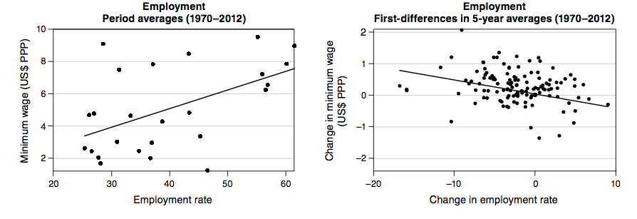
Employment effects:
We can´t draw firm conclusions from aggregate cross-country evidence like this
Source: Cahuc et al. (2014), based on OECD data

Slide 41
We need to evaluate minimum wage changes against a credible counterfactual
Types of studies that try to do this (with varying success)
Time-by-state/province panels (US, Canada)
Cross-country panels
Individuals bound by minimum wages

Slide 42
Time-by-state/province panels
N_{it} = β MINW_{it} + x_{it}γ + λ_{t} + θ_{i} + ε_{it}
N= employment, MINW = measure of minimum wage; x = vector of control variables, λ = year fixed effect, θ = state/province fixed effect
This is a difference-in-differences estimator; counter-factual is employment effect in regions in which minimum wages increased by different amount or not at all
Often applied to specific groups (teens etc.) or to low-wage industries

Slide 43
Time-by-state/province panels
Mixed results, but majority of studies suggest negative effects, albeit small in many cases
E.g: Card (1992), Burkhauser et al. (2000), Deere et al. (1995),
Keil et al. (2001); Sabia (2006); Zavodny (2000)
The state case studies can be regarded as special case of this difference-in-differences set-up
Card & Krueger (1994) is the most famous example – compared employment effects in New Jersey and Pennsylvania. No disemployment found. Michl (2000) later argued that hours declined, though.

Slide 44
Time-by-state/province panels
In a series of articles Dube and others criticized previous panel studies
State-specific trends should be included to account for factors that affect evolution of employment in general, correlated with minumum wage changes
N_{it} = β MINW_{it} + x_{it}γ + φ_{i}T+ λ_{t} + θ_{i} + ε_{it}
T= state-specific linear time trend
Inclusion of T reduced β to near zero
E.g: Dube et al.(2007); Dube et al. (2010)

Slide 45
Time-by-state/province panels
Recent critique of Dube et al. by Meer & West (2016):
If minimum wage affects growth of employment rather than its level, state-specific trends lessen true effect of minimum wage
ΔN_{it} = β ΔMINW_{it} + Δx_{it}γ + φ_{i}T + λ_{t} + Δε_{it}
Inclusion of T reduces β to near zero
Controversy is likely to continue…

Slide 46
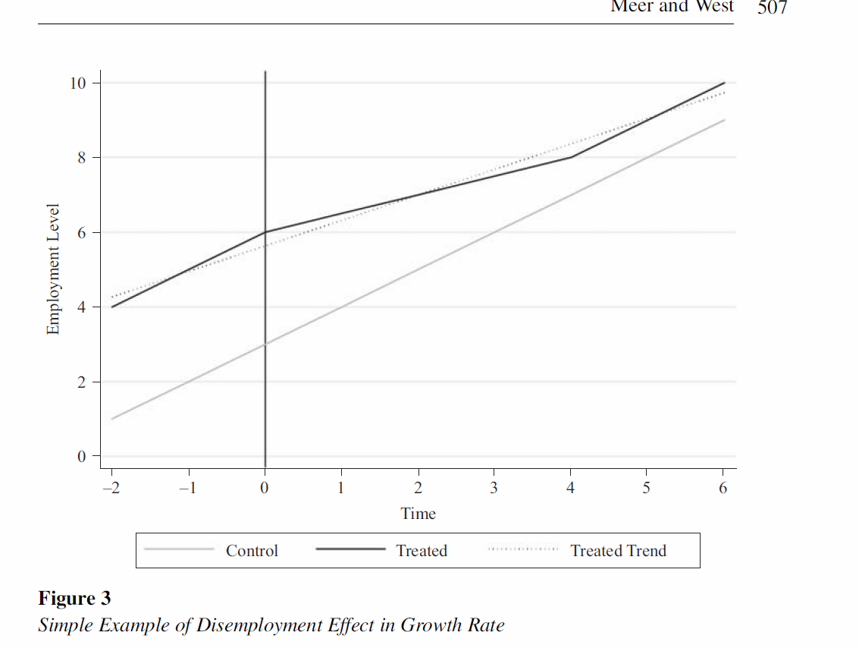
Time-by-state panels
Example of disemployment effect in growth rate
_{Source: Meer & West (2016)}

Slide 47
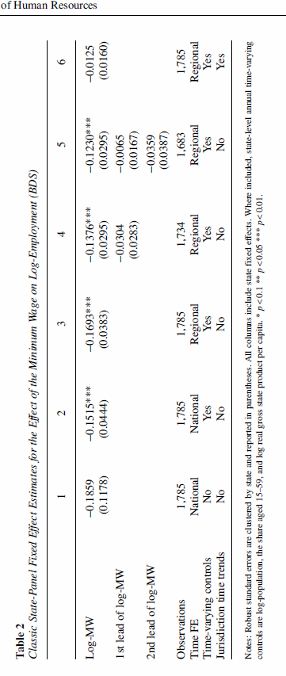
Time-by-state panels
Regressions with level of employment
_{Source: Meer & West (2016)}

Slide 48
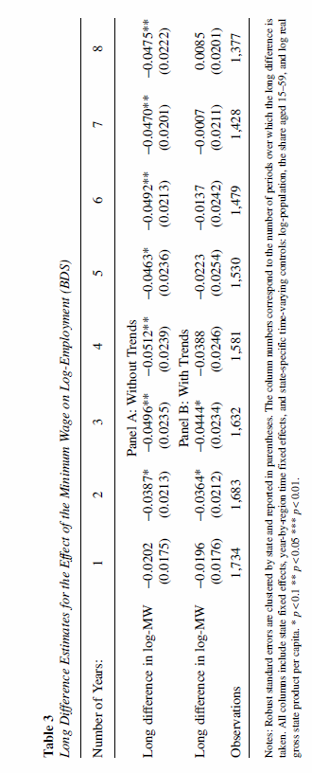
Time-by-state panels
Regressions with growth of employment
_{Source: Meer & West (2016)}

Slide 49
Cross-country analysis
Use similar specifications as in the early time-by-state panels
Unobserved heterogeneity across countries likely to be more serious problem than in time-by-state panels
Minimum wage mismeasured in some cases
Few studies exist, but suggest negative effects
E.g. Addison & Ozturk (2012); Neumark and Wascher (2004)

Slide 50
Employment effects for individuals bound by minimum wages: International evidence
Often uses firm level data, tracking worker histories
Allows analysis of (i) worker flows in and out of employment and (ii) how different groups are affected at firm level
A small overall employment effect may mask substantial differences across groups

Slide 51
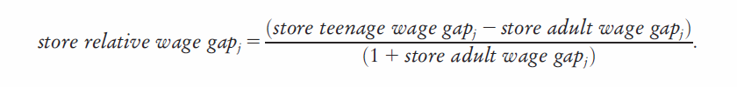
Employment effects for individuals bound by minimum wages: International evidence
Giuliano (2013) uses payroll records from one retail firm in US
Exploits variation in minimum wage increases across states
Uses WAGEGAP, for teens and adults at shop level, plus their relative gap at shop level

Slide 52
Employment effects for individuals bound by minimum wages: International evidence
_{Findings in Giuliano (2013):}
1. Overall employment increased for teens – mainly driven
_{by more inflows}
2. But teen employment decreased in markets with high
_{minimum}
3. Substitution from adults towards teens

Slide 53
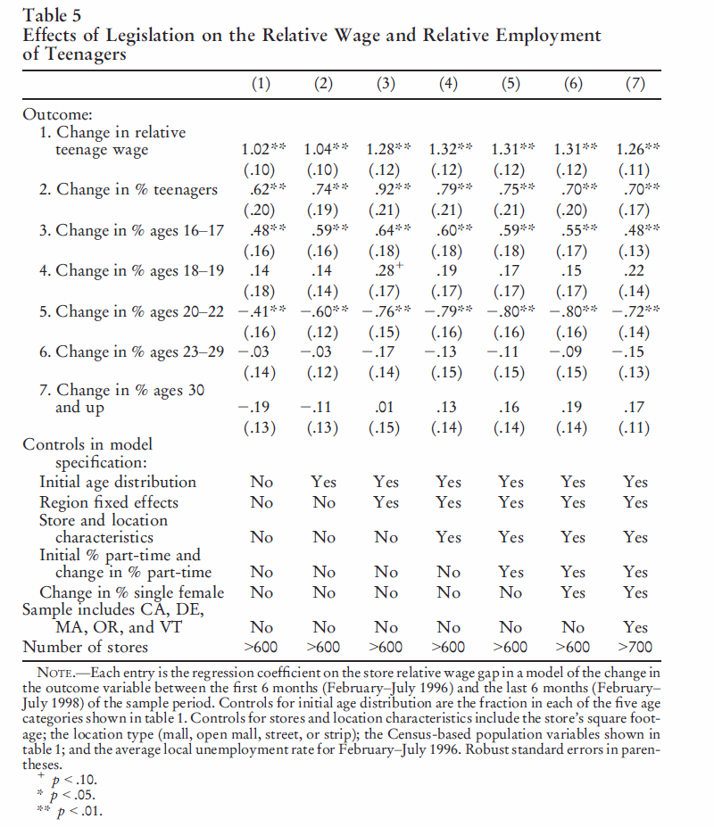
Effects on relative wage and relative employment of teens
_{Source: Giuliano (2013)}

Slide 54
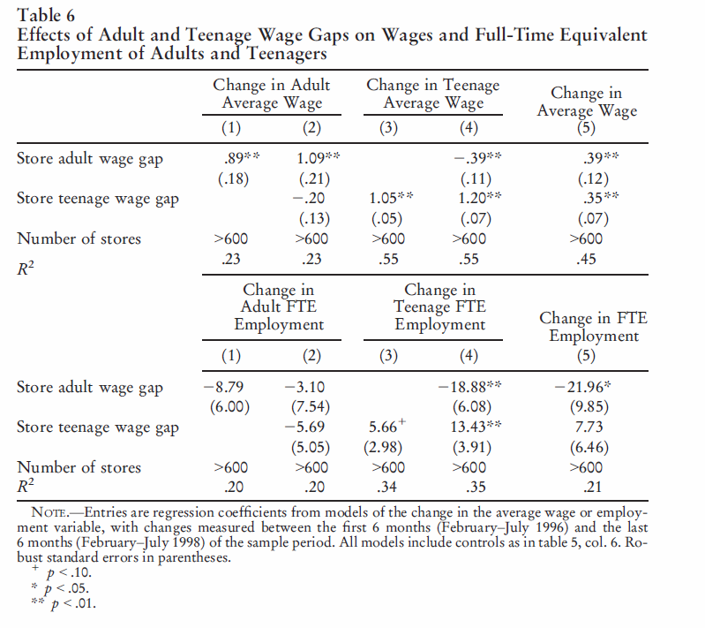
Effects on employment of adults and teens
_{Source: Giuliano (2013)}

Slide 55
Employment effects for individuals bound by minimum wages: International evidence
Abowd et al. (2000) examined US and France:
Two countries with very different minimum wage levels
Compares outcomes for workers constrained by the minimum wage to workers with slightly higher wages
Find large disemployment effects for France, none for US
Similar effects for France in Kramarz & Philippon (2001)
Studies from UK tend to find small employment effects
E.g.: Machin & Wilson (2004); Stewart (2002, 2004)

Slide 56
Employment effects for individuals bound by minimum wages: Swedish evidence
Skedinger (2006, 2015) used Abowd et al. (2000) methodology plus WAGEGAP. Examined hotels and restaurants and retail, respectively
_{Findings:}
1. Minimum wage increases increase worker separations 2. Minimum wage decreases increase hirings
3. Substitution away from low-wage workers
_{4. No effects on hours}

Slide 57
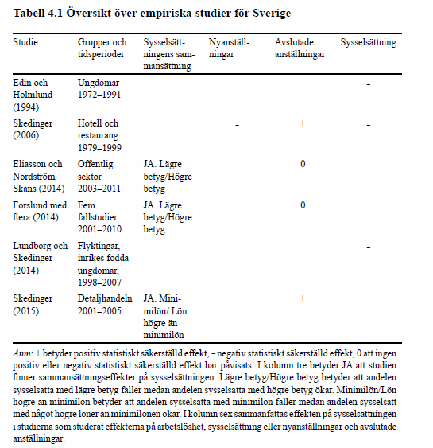
Overview of Swedish studies (with different methodologies)
Source: Swedish Labour Policy Council (2016)

Slide 58
Effects on employment: Summing up
Overall very mixed results – some find negative effects, some find no effects, some find positive effects
Negative effects dominate, but they are often small
Negative effects, if any, tend to be concentrated to vulnerable groups
More negative effects in Swedish studies than in other studies. Even if no overall employment effect, vulnerable groups are affected negatively
Combined evidence is not very consistent with predictions from competitive model, more consistent with models that rely on labour market frictions – search and matching models

Slide 59
Current policy issue
The Swedish minimum wage model has come under increasing pressure from supply and demand forces
Skills are deteriorating, both in absolute terms and in relation to other countries
- Large inflow of low-skilled immigrants (largest number of asylum seekers per capita in EU)
- Large decline in skills among school pupils and adults (largest among countries participating in OECD tests)
Decreasing demand of low skilled, due to skill-biased technological change and globalization

Slide 60
Changes in the average literacy score of adults between 1994–98 and 2012, natives and those with immigrant background
Source: Swedish Labour Policy Council (2016), based on IALS and PIAAC data

Slide 61
Labour market responses to increasing supply and decreasing demand of low skilled
Either relative wages of the low skilled decrease or their relative employment decreases
Labour market institutions determine whether wages or employment adjusts
High minimum wages in Sweden prevent relative wage adjustment, so relative employment should adjust - and this is what we see

Slide 62
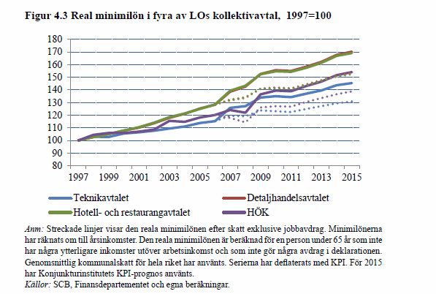
Very large increases in minimum wages, despite income tax credits and lower than expected inflation
Source: Swedish Labour Policy Council (2016)

Slide 63
Arguments against minimum wage reductions in collective agreements
“Employment is not responsive to changes in the minimum wage”
“Reductions need to be very large to be effective, with unacceptably lower standards of living”
“Other measures – education, employment subsidies, etc. – should be used instead”
“Reductions will spill over to workers earning above the minimum wage”
“The jobs with lower minimum wages will be taken by labour immigrants from the EU. Under EU law we can’t stop that”

Slide 64
Methods of minimum wage reductions in collective agreements, with different trade-offs between employment and income disparities
Across-the-board, permanent reductions for existing jobs
Permanent reductions targeted towards new types of low-skilled jobs
Reductions for new entrants in low-skilled jobs with temporary duration, combined with income tax credits and employment subsidies

Slide 65
Summary and conclusions
The minimum wage is a widely used policy instrument, but comes in a variety of forms
Wages increase. Mainly among those directly affected, but often also among those with higher wages
Employment increases in many cases when the minimum wage is low, but negative effect seems more likely with high minimum
Compositional employment effects are important
Overall, empiricals findings are more consistent with search and matching models than with the competitive model
Not much is known about long-run effects on wages and employment

