Slide 1
Minimum wages
Reading instructions:
Borjas sections 3-10, 4-9 + lecture notes
Theory
What do we know? Empirics.
A Swedish perspective (based on a research report on minimum wages from a Swedish perspective)

Slide 2
The Impact of the Minimum Wage on Employment
(Borjas)
Dollars
A minimum wage set at w− forces employers to cut employment (from E* to E−). The higher wage also encourages (ES - E*) additional workers to enter the market. The minimum wage, therefore, creates unemployment.
S
w⁻
w*
D
E⁻
E*
E_{S}
Employment

Slide 3
Noncompetitive labor markets: monopsony (Borjas)
Monopsony market exists when a firm is a lone buyer of labor (acting as a sole employer of labor in the market)
Such a firm must increase wages to attract more workers

Slide 4
Nondisriminating monopsonist
Must pay all workers the same wage, regardless of each worker’s reservation wage
Must raise the wage of all workers when attempting to attract more workers
Employs fewer workers than would be employed if the market were competitive

Slide 5
The Hiring Decision of a Nondiscriminating Monopsonist
A nondiscriminating monopsonist pays the same wage to all workers. The marginal cost of hiring exceeds the wage, and the marginal cost curve lies above the supply curve. Profit maximization occurs at point A; the monopsonist hires EM workers and pays them a wage of wM.

Slide 6
The Impact of the Minimum Wage on a Nondiscriminating Monopsonist
Dollars
MC_{E}
The minimum wage may increase both wages and employment when imposed on a monopsonist. A minimum wage set at w− increases employment to E−.
S
A
w*
w⁻
w_{M}
VMP_{E}
E_{M}
E⁻
Employment

Slide 7
Effect on employment depends on level of initial wage when monopsony power
When the wage is below the market wage, employment increase with an increase in the minimum wage.
When the wage is above the market wage, employment falls with an increase in the minimum wage.

Slide 8
Search and matching framework
Similar results as monopsony model
A higher wage stimulates search inducing employment to increase.
A higher wage reduces job creation as more expensive to hire.
First effect can dominate when w is low, but the second effect always dominate when w is high.

Slide 9
Empirics
Numerous studies, varying results
Mainly carried out in low minimum-wage countries (legislated minimum wages)
Majority of studies find that minimum wages reduce employment. The effects are not very big though. A 10 percent increase in the minimum wage reduce employment by 1-3 percent.
More clear results that minimum wages reduce employment in high minimum wage countries (France, Sweden, etc). Also larger effects (comparing France and US.)

Slide 10
US studies, comment
The first studies showed negative employment effects of minimum wages.
In 1990s new approach focusing on restaurants. Card and Krueger. Natural experiments. Partial equilibrium. Less negative, zero, and even positive effects on employment from minimum wages.

Slide 11
Swedish perspective
Based on a research-based report on wages and wage formation in Sweden (2016).
Challenges on the Swedish labour market:
Drop in skill/performance/education
Increased imigration where average skill/performance/education lower

Slide 12
Change in average reading skill points IALS 1994–98 and PIAAC 2012. red: foreign born, blue: born in country

Slide 13
Employment rate based on reading skill scores IALS 1994 och PIAAC 2012, procent
 | Level 1 | Level 2 | Level 3 | Level 4 | Relative employment rate level 1/level 3
IALS | 47 | 62 | 71 | 71 | 0,66
PIAAC | 51 | 70 | 79 | 86 | 0,65

Slide 14
Minimimum wage bite in different countries, percent

Slide 15
Minimum wage bite in four different agreements on the Swedish LM

Slide 16
How will a change in the minimum wage affect employment?
Theory:
- Increased minimum wages increase employment if initially low.
- Increased minimum wages reduce employment if initially high.

Slide 17
Swedish empirical studies
Six studies
- one with focus on refugees
Majority of studies find negative employment effects of higher minimum wages (more so than international studies)
- four out of six (two with zero effects)
Negative composition effects
- higher minimum wages reduce employment for workers with less attachment to the labour market (even in the studies that find zero effects on the number of separations)

Slide 18
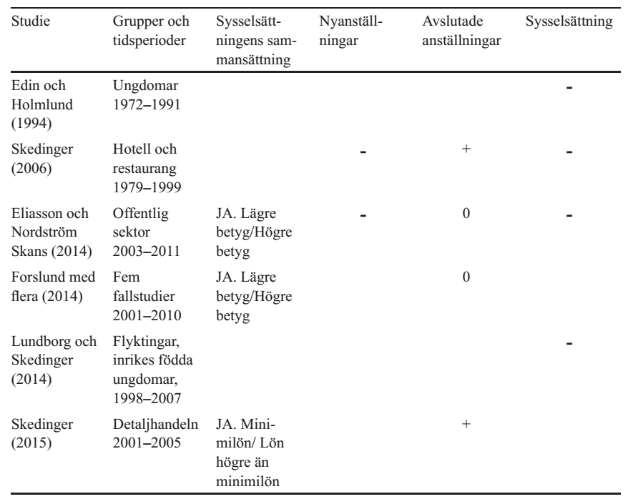
Overview of the the empirical studies for Sweden

Slide 19
Tendencies to under-estimate the true effects of minimum wages
Focus on separations does not provide the full picture
- hires are also important
Potentially different effects on unemployment if weaker or stronger workers are separated…
Current studies captures short run effects
- In LR easier to change capital for labour - New markets

