Slide 1
The German Labor Market Miracle Jonas Frycklund, Acting Chief Economist, april 2016

Slide 2
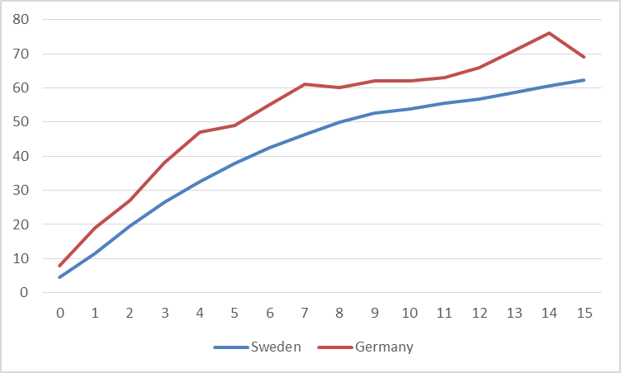
Employment rates for refugees by years in the country
”It takes five years for half of refugees to reach employment in Germany”
”It takes eight years in Sweden”
Source: SCB, IAB, own calculations

