Slide 1
Comments on ”The German Labor Market Miracle: An Assessment” by Michael C. Burda
Karolina Ekholm
State Secretary
Ministry of Finance

Slide 2
Different hypotheses explaining the miracle
  The Hartz reforms reducing unemployment benefits and increased pressure to accept job offers.
  Decentralization of the wage-setting process leading to wage moderation.
  Increased cost competitiveness due to offshoring and the development of international value chains.
Increased competitiveness due to poor performance of other EA members, leading to a relatively weak euro.

Slide 3
Steady increase in the current account after introduction of the euro

Slide 4
Facts that need to be explained
  Increased employment
  Increased wage dispersion
  Aggregate wage moderation
  Increased labour force participation
    Favours Hartz reforms hypothesis over wage moderation hypothesis
Maybe the right question is how much different factors contribute to explaining the outcome.

Slide 5
Small difference in employment rates
Employment rate (15-74 years)
Notes: Seasonally adjusted data
Source: Eurostat

Slide 6
Unemployment considerably higher in Sweden…
Notes: Seasonally adjusted data
Source: Eurostat

Slide 7
…but with a different composition
 | 2014
Adult population, 25-74 years | Sweden | Germany
Unemployment | 5,7 | 4,7
Men | 5,9 | 5,0
Women | 5,6 | 4,4
Nationals | 3,8 | 4,1
Foreigners | 14,0 | 7,5
Pre-primary, primary and lower secondary edu.* | 13,2 | 11,8
Share of long-term unemployed (12 months+) | 18,9 | 44,3
Youth, 15-24 years
Unemployment | 22,9 | 7,7
Excluding students | 12,5 | 6,0
Share of long-term unemployed (12 months+) | 5,9 | 23
NEET | 7,2 | 6,4
Men | 7,5 | 5,5
Women | 6,8 | 7,2
Notes: *Quarterly frequency, otherwise annual frequencies Source: Eurostat

Slide 8
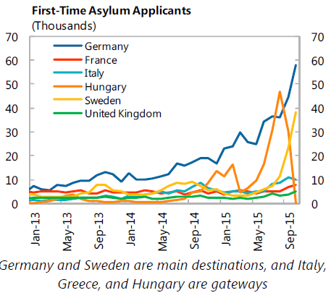
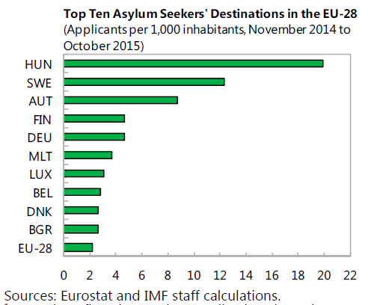
Large inflow of asylum seekers last year in both Germany and Sweden
Will refugee immigrants integrate faster in the German labour market?

